Slide 1
NORCAL PREMIER SOCCER
Club Development Seminar
June 30, 2019

Slide 2
Time | Presentation Topic | Presenter(s)
8:30am | Welcome & coffee/bagels social
9:00am | Club Fundraising Workshop | Nick Lusson (Club Services Coordinator, NorCal Premier Soccer)
9:45am | Placing a Priority on Injury and Illness Prevention | Cindy J. Chang, MD Primary Care Sports Medicine Brian Bosl PT, DPT, OCS, CSCS Bill Tilson, ATC (Sports Medicine Center for Young Athletes UCSF - Benioff Children’s Hospital Oakland)
10:45am | Break
11:00am | Maximizing Relationships with Park & Recreation Departments | Noel Munivez (Hayward Area Recreation & Park District) Bryan Cobb (Newark Recreation & Community Services Department)
12:00pm | Lunch
1:00pm | Vision of a Club | Frans Hoek (former coach at KNVB, FC Barcelona, Manchester United, Bayern Munich)
2:00pm | Club Development & Coach Education | Austin Daniels (US Soccer Federation)
3:00pm | Break
3:15pm | Club Technology Strategies | John Weinerth (VP of Soccer, SportsEngine)
3:45pm | Strategies to Build a Girls Soccer Program & Womens Coaching Staff | Erin Sharpe (Chair, NorCal Premier Soccer Women’s Committee)

Slide 3
Fundraising Workshop
Getting Organized
Fundraising Strategies
Who is going to do this?

Slide 5
Planning it Out
RESEARCH - What do you have to work with?
Decide in advance where the money will go
NEEDS
GOALS
DREAMS
Notes:
RESEARCH - What do you have to work with – parents/members in club, alumni, community (businesses, government, other NGO’s), parks, location, events
Decide in advance – avoid fights later on in case you’re very successful

Slide 6
Notes:
Selection of fundraising strategies
Screen through organization values

Slide 7
Materials Development
Hook Images
Case Statement / Annual Report
Videos (short & long)
1-Pagers
Elevator Pitch

Slide 8
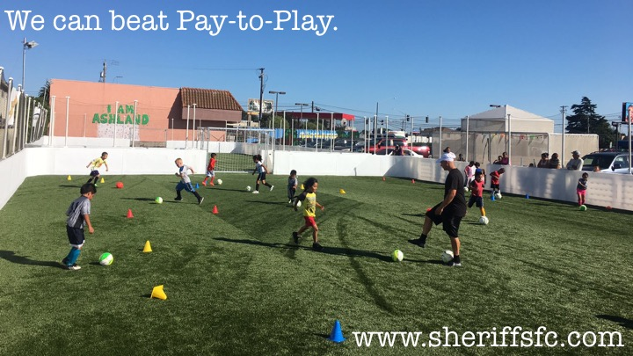
Notes:
Hook image example

Slide 9
Notes:
Example of Case Statement – Soccer w/out Borders

Slide 10
Elevator Pitch
Hook
NorCal Premier Soccer leads the country in revolutionizing youth soccer.
Content
238 Member Clubs – over 100,000 youth players Regional & State Leagues & Cups
Action
Looking for people like you who share our passion to get involved in strengthening our initiatives and establish Northern California as the best quality environment for the game in our country.
Adult Leagues Inclusive/collaborative Women’s Committee
Free PDP program Subsidized Coach Education, Club Dev, Referee Dev
Notes:
Elevator Pitch worksheet

Slide 11
Materials Development
What makes you unique & stand out? Why should I support you and not ___?
Different strokes for different folks
Which is more effective?
“Please donate $100 to our soccer club”
vs.
“Please donate $100 so Jack can afford a uniform to play on the U12 team this year”

Slide 12
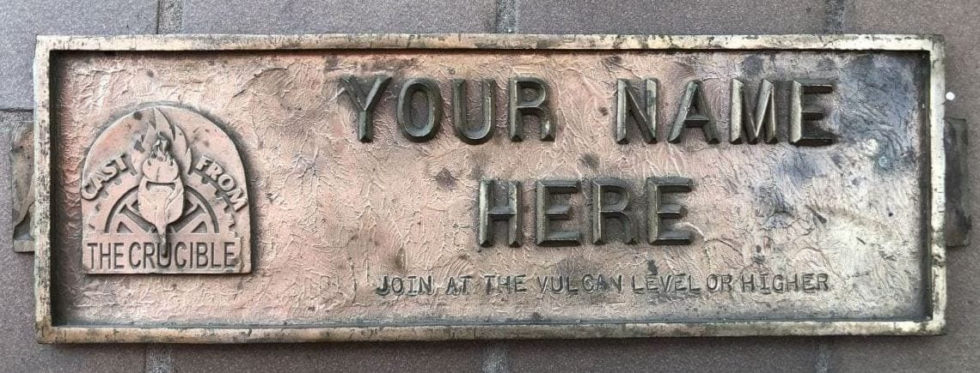
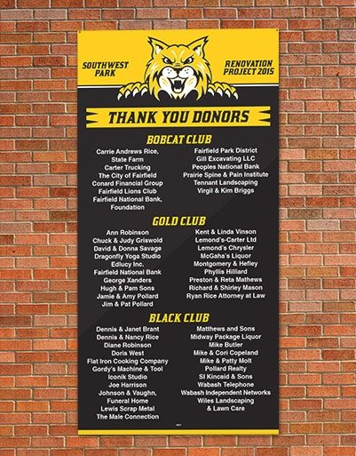
Notes:
Hook image example

Slide 13
Setting up the Process
Safety Protocols for $$$ Collection
Donor Cultivation
Who?
Evaluation
Identification & Research
Relationship Building
Inclusion
The Ask
Gratitude & Reporting

Slide 14
Fundraising Strategies
Hand-in-hand with Organization Promotion/Awareness
Club Marketing Presentation
Community Visibility
How do you get other people to promote you?

Slide 15
Worksheet
______________
Who leads this?
______________
When is it done?
______________
What strategy?
______________
Who leads this?
______________
When is it done?
______________
What strategy?
______________
Who leads this?
______________
When is it done?
______________
What strategy?
Notes:
Elevator Pitch worksheet

Slide 16
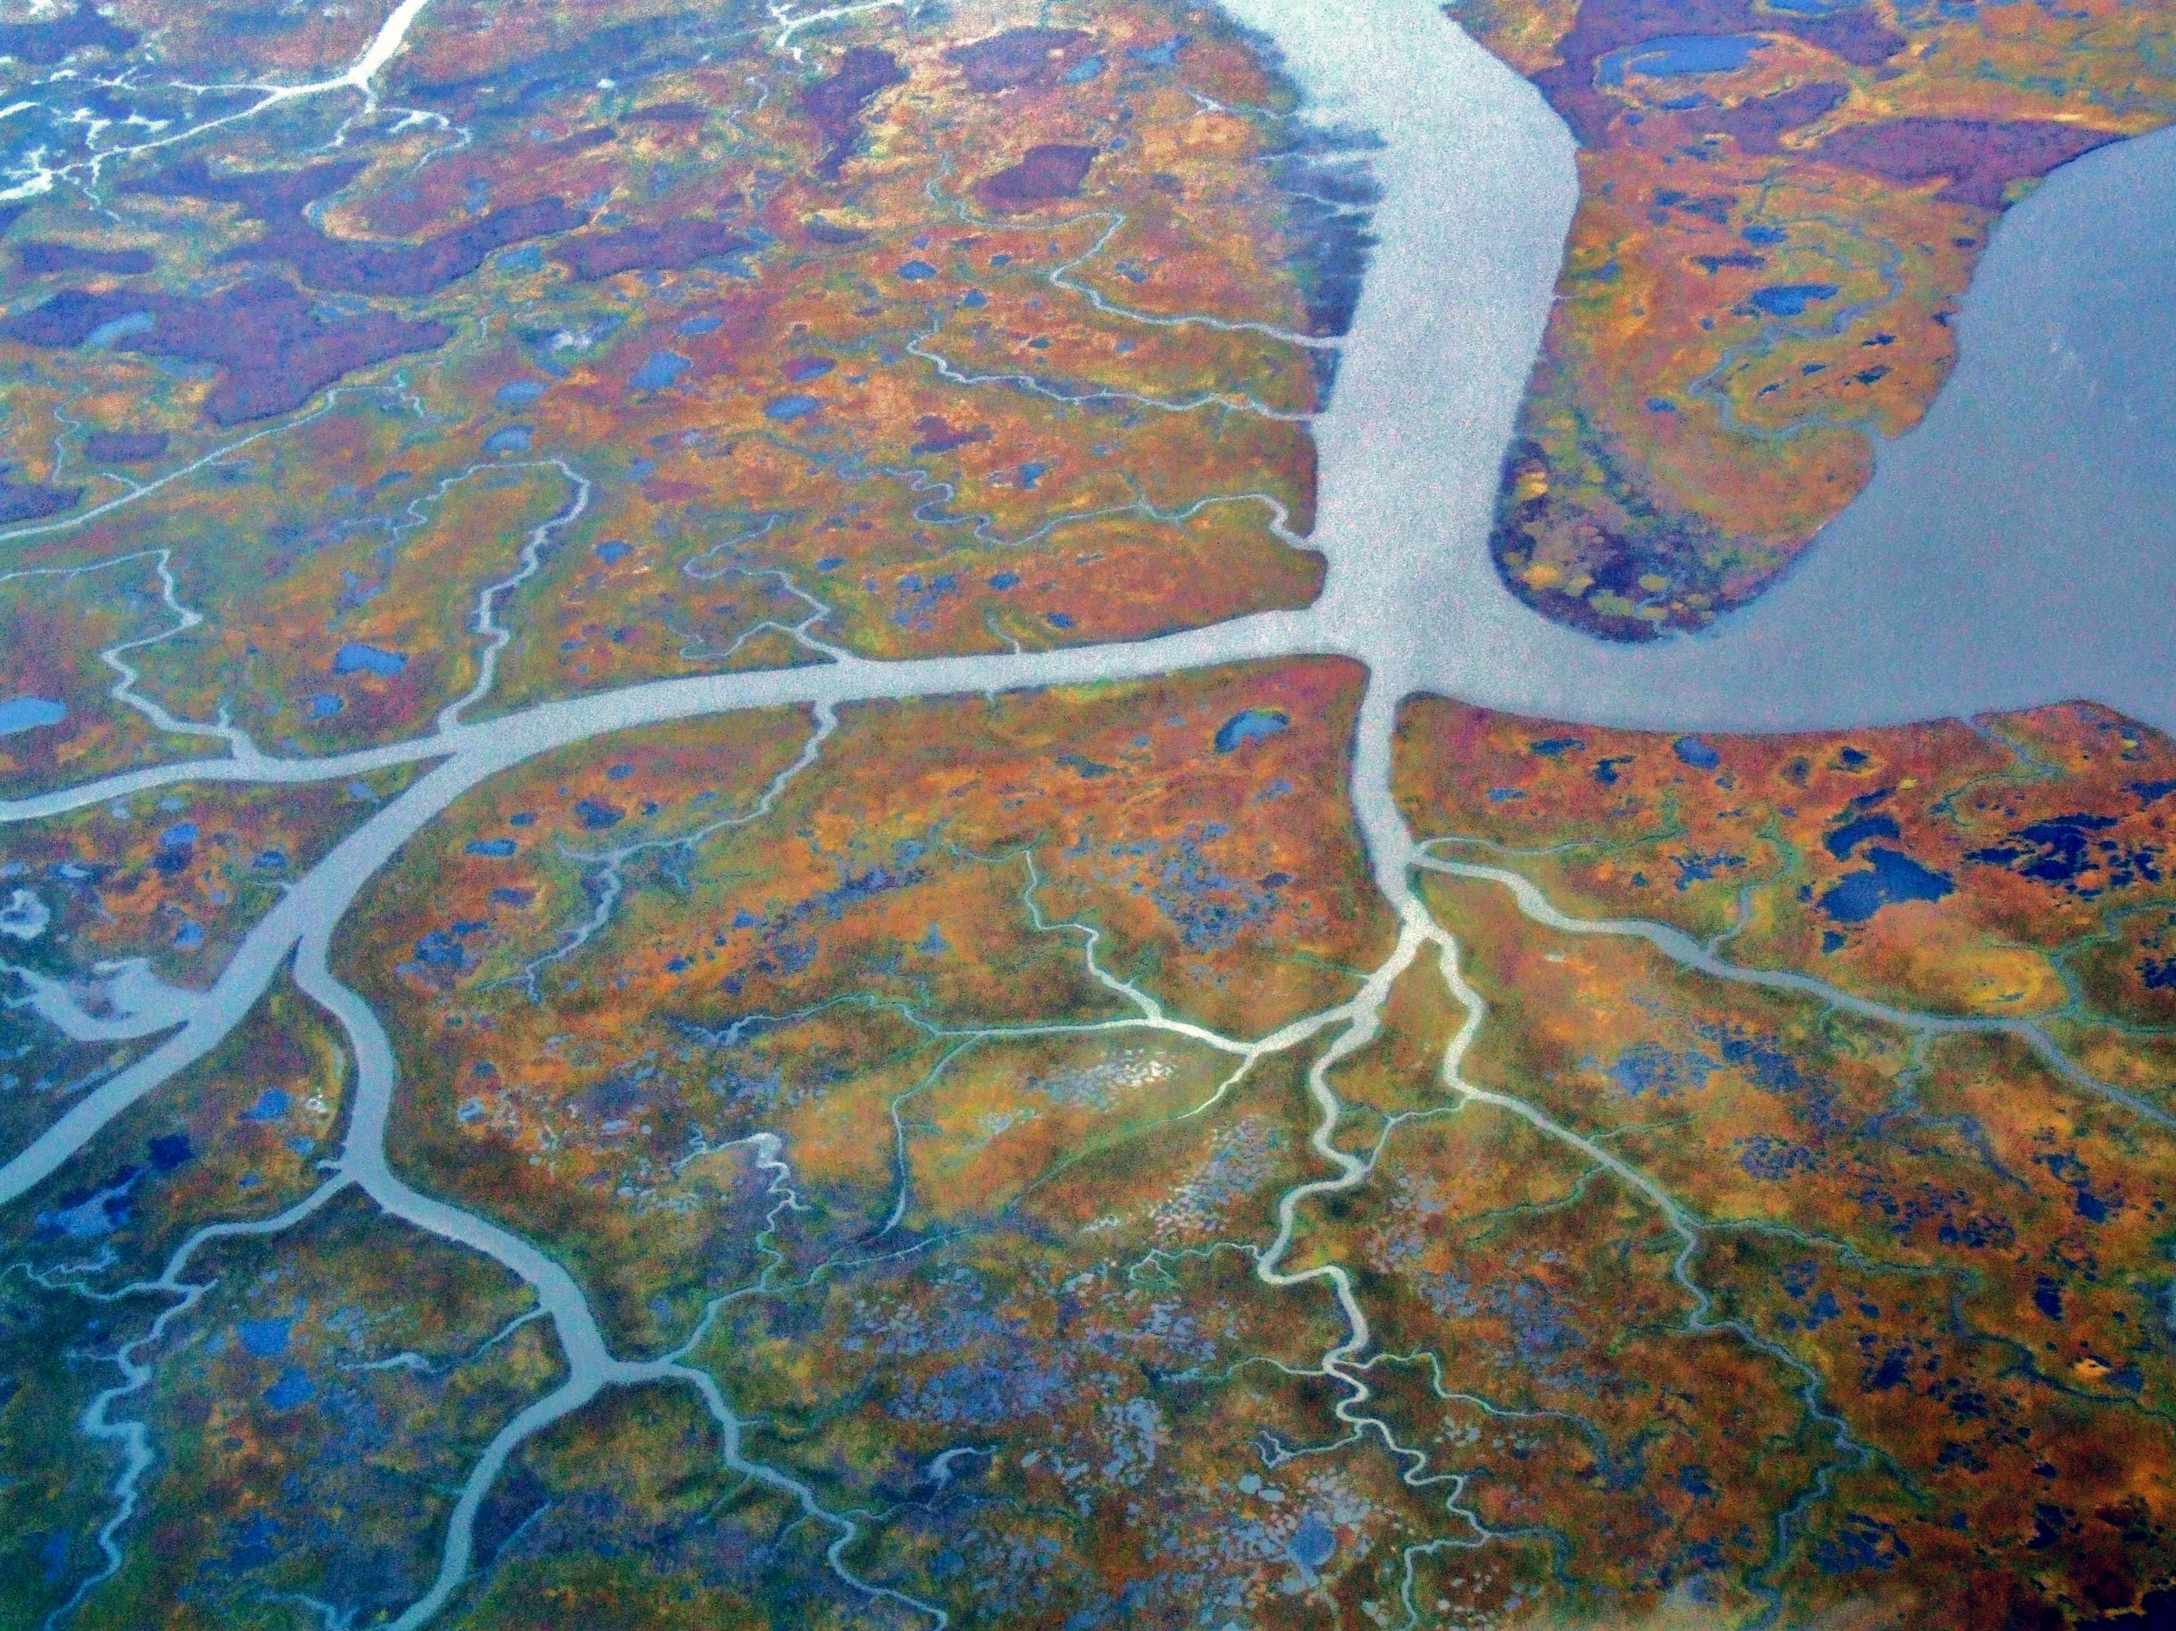
Sponsors
Grants
Partners
Earned
Donations
Trade in Kind
Notes:
Selection of fundraising strategies
Screen through organization values

Slide 17
Grants
Corporate, Government, Foundation
Fall Grant-writing Presentation
Reverse Engineer – Be Creative (non-soccer)
Be Selective & Be Willing to Fail
Grant Writing USA & Association of Fundraising Professionals

Slide 18
Donations
Capital Campaign Rule of 1/3’s
Are you asking? Registration process, reminder communications, embedded calls to action
Employer Matching Donations
Easy hits locally – corporate chain stores
Crowdfunding platforms
2 giving seasons, Amazon Smile

Slide 19
Earned Income
Tournaments, Camps, Clinics
Apparel & Club Merchandise
Holidays
Long-Term Business Ventures

Slide 20
Sponsors
Jerseys, warm-ups, tents, fields
Does the Sponsor Values match Yours?
How do you determine the value?
(associated costs of printing & removal)
Quantify the ROI for the Sponsor

Slide 21
Trade in Kind
List your Needs
(product, food, services, marketing)
Look from Within First
(parent info at registration)
Long-term Relationships with Local Partner Businesses

Slide 22
Partners
Other Community Organizations
Other YSO’s
Become the Charity of Choice

Slide 23
Who the hell is going to do all of this?
Commission based fundraiser
Delegate & Empower
Gamification
Be Realistic & Plan for Success

Slide 24
THANK YOU FOR COMING!
Nick Lusson
NorCal Premier Soccer
Club Services Coordinator
nlusson@norcalpremier.com

